Slide 1



Heart Failure Patient Survival
presentation By
Pornkanok Tantewee

Slide 2
Workflow process
Training data
Normalization
Train data in K-NN Algorithm
Determine hyperparameter values
K-NN model
Evaluation
K-NN
80%
Find the best K by using 5-fold cross validation
Prep data
Raw data
Test Model
Splitting
20%
Testing data
Training data
Normalization
Train data in K-NN Algorithm
Determine hyperparameter values
K-NN model
Evaluation
Decision Tree
80%
Find max depth by using 5-fold cross validation
Prep data
Raw data
Test Model
Splitting
20%
Testing data

Slide 3
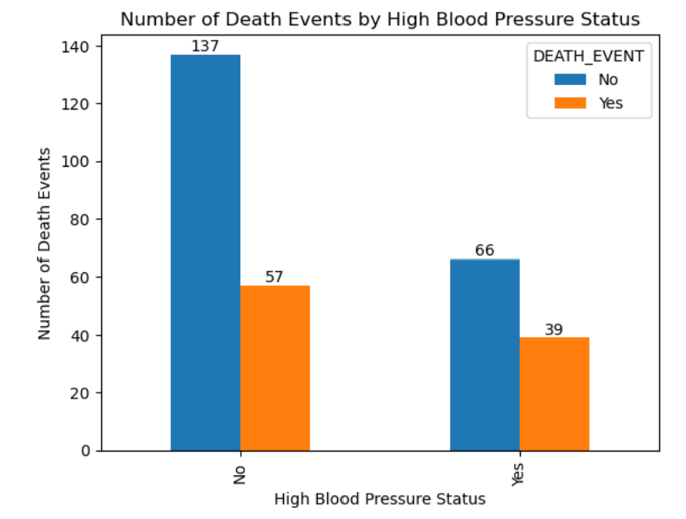
1.What is the impact of high blood pressure on the survival rate of heart failure patients?
meaningful questions

Slide 4
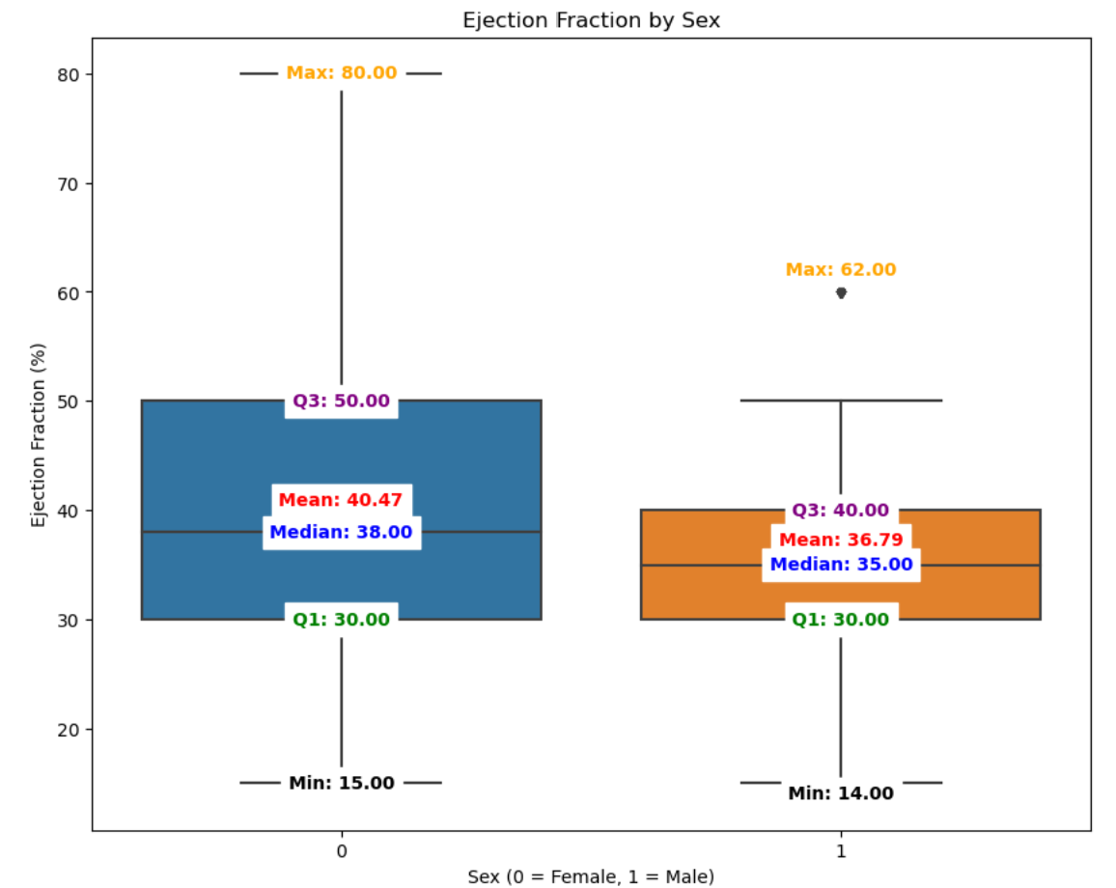
2.How does the ejection fraction vary between males and females?
meaningful questions

Slide 5
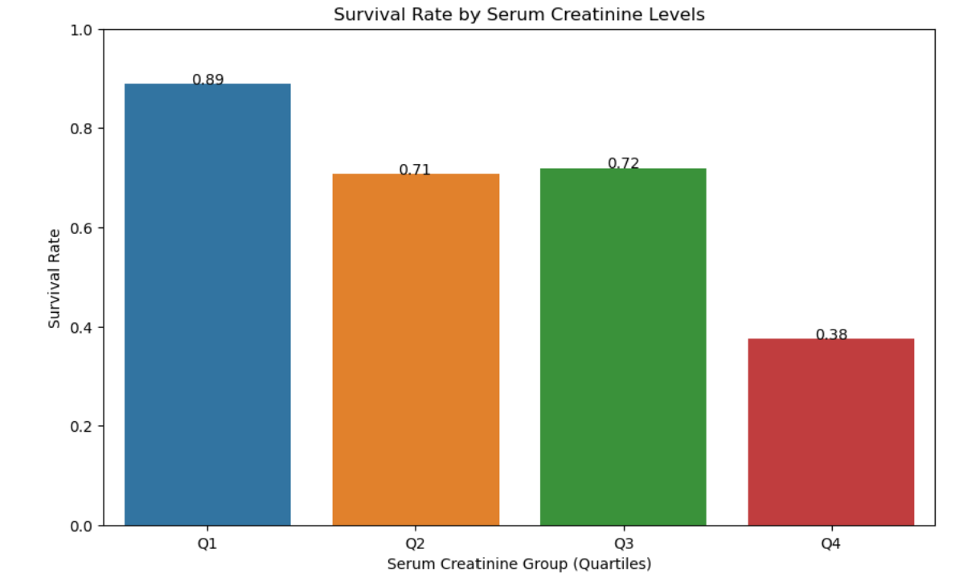
3.How do serum creatinine levels affect the survival rate of heart failure patients?
meaningful questions
Low
serum creatinine levels
High
Q1
Q2
Q3
Q4

Slide 6
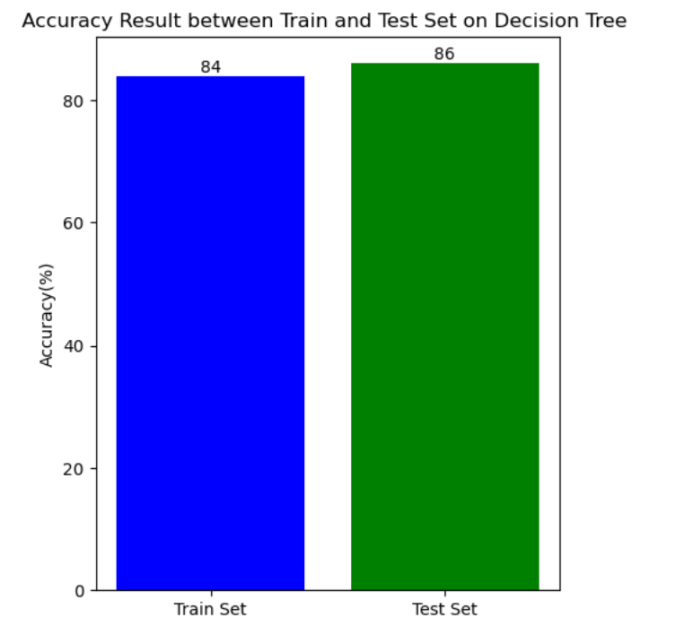

Slide 7
